Slide 1


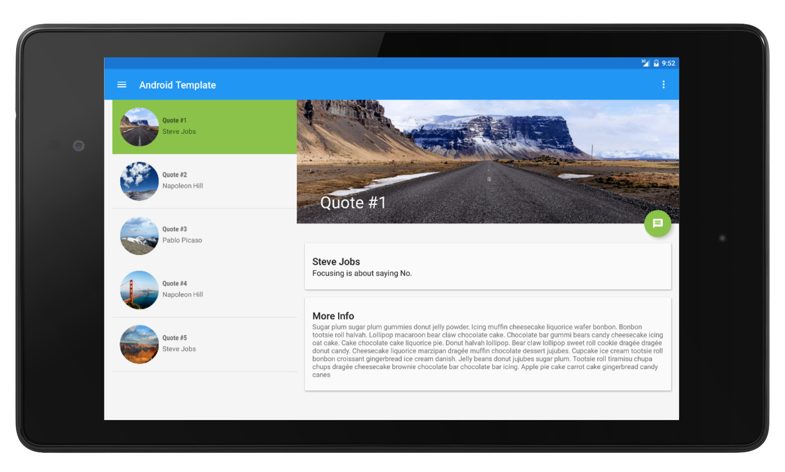

WELCOME TO ONE DAY WORKSHOP ON ANDROID
Dr. Vikrant Shaga
MIT(E) Aurangabad

Slide 2
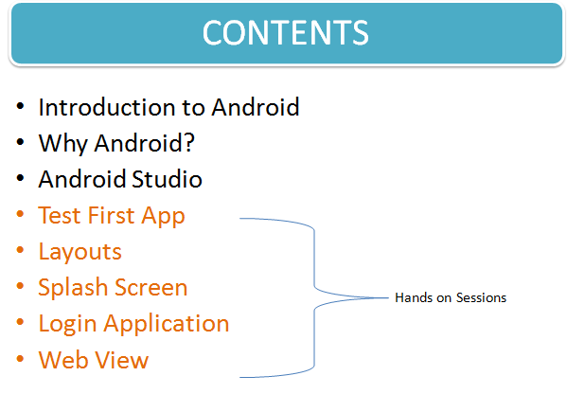

Slide 3
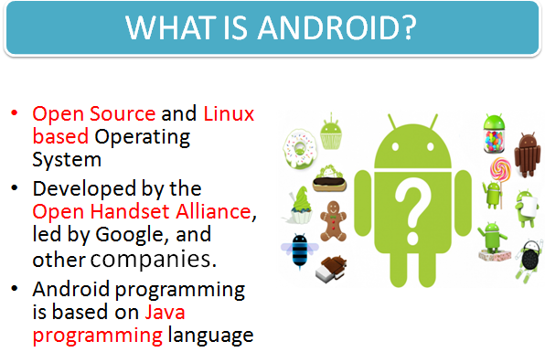

Slide 4
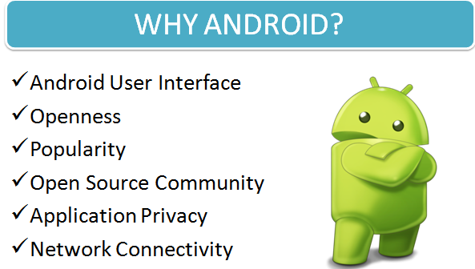

Slide 5
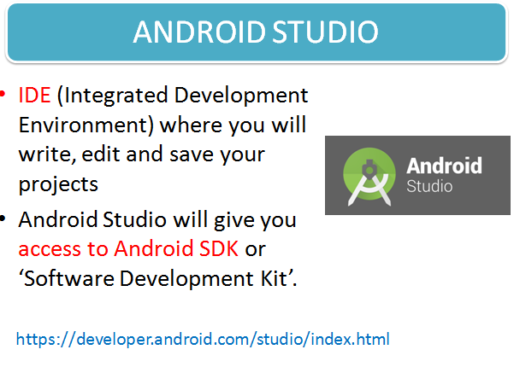

Slide 6
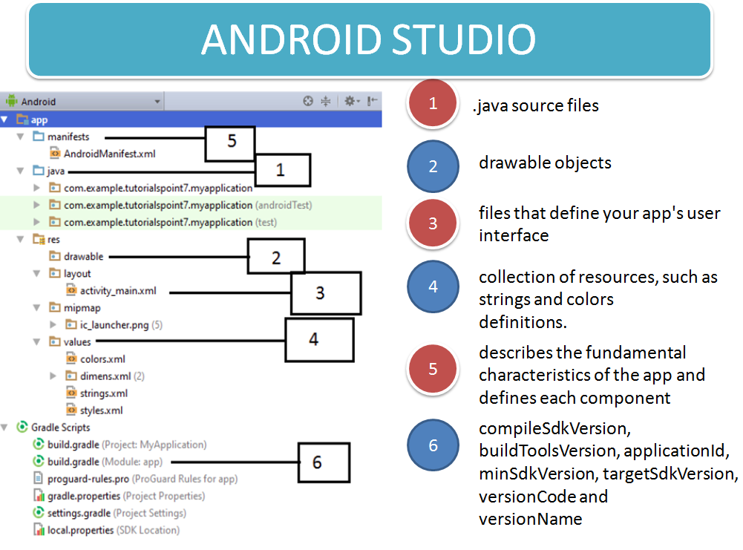

Slide 7


